Slide 1

Canning Vegetables Safely
Lunch & Learn
12 noon to 1 pm
June 25, 2012

Slide 2
Canning Vegetables
Acids naturally found in foods help control microbial growth
Vegetables are low in acid and must be canned in a pressure canner
Higher temperatures obtained in a pressure canner destroy the spores of Clostridium botulinium
If not destroyed, the spores could germinate and grow, producing the deadly botulinum toxin

Slide 3
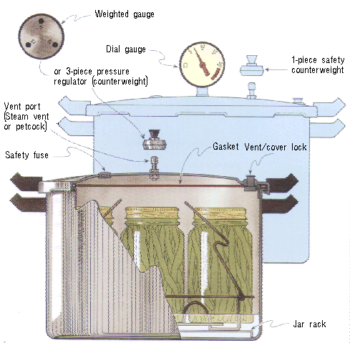
Pressure Canning
High temperatures (240°F and above)
Dial gauge measures incremental changes in pressure
Weighted gauge measures pressure at 5,10, or 15 pounds (psi)
Weighted Gauge
Dial Gauge

Slide 4
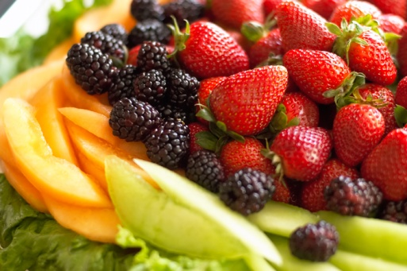
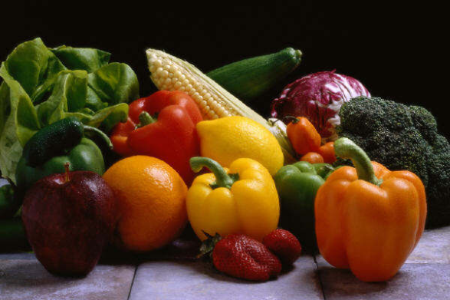
Acid Level & Canning Method
What is the pH (acidity) of the food?
Below pH 4.6 Above pH 4.6
Boiling Water Canning Pressure Canning
Fruits, Pickles, Salsa Vegetables, Meat

Slide 5

Recipe for Danger
Prepare vegetables (pH greater than 4.6)
Place in canning jar
Seal to remove oxygen (no heating necessary) Try the oven or dishwasher! ☹
Store at room temperature.
Wait… a bit. As the spores of C. botulinum germinate in your product, toxin is formed. Your product will be decidedly deadly.

Slide 6
What does this mean for canning?
Foods with pH above 4.6 that you want to can:
➔Process in a pressure canner to destroy spores of C. botulinum.
➔Adding pressure increases temperature
  At sea level, water boils @ 212°F
  10 pounds pressure (psi) - 240°F
  15 pounds pressure (psi) - 250°F

Slide 7
Hints for Canning Vegetables Safely
Select high quality vegetables
Wash all vegetables and peel and/or blanch if required
Adjust seasoning as desired
Place filled jars on a rack in 2-3 inches of water
VENT canner for 10 minutes prior to closing vent port
Do not thicken with flour, corn starch, or other ingredients; do not add butter or fat
Do not adapt jar sizes

Slide 8
Don’t Forget
Process at the correct temperature (pressure)
Follow an up-to-date tested recipe. Now is not the time to be creative!
Adjust for elevation.
If at ANY time during the process
the pressure falls below target,
bring the pressure back up and
start timing from the beginning.
NEVER force cool a canner.
*Note: darker areas on the state map have an elevation above 1,000 feet. Increase time when boiling water canning; increase pressure when pressure canning.

Slide 9
A word about canners and cookers
Pressure canners and pressure cooker are NOT necessarily the same thing.
The heat in the canning process is the come-up time, the process time and the cool down time. A cooker often heats and cools too quickly.
Pressure canners must hold at least 4 Quart jars and be able to regulate pressure at 5, 10, and15 pounds (psi).
➔ Use of a pressure cooker is not recommended for home canning.

Slide 10
What if….
Jars fail to seal: reprocess or refrigerate or freeze within 24 hours.
To reprocess jars: empty the jars, heat the contents (hot-pack) and add to jars leaving sufficient headspace, apply new lids, vent and process for the full time indicated.
More than half the liquid is lost in the jar: excess liquid loss often indicates excessive temperature (pressure) fluctuation. Losing more than half the liquid that you added may indicate under-processing. Store these jars refrigerated.

Slide 11
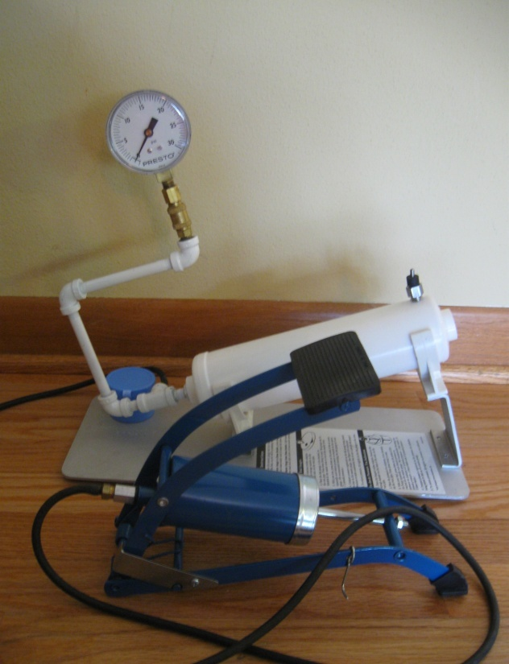
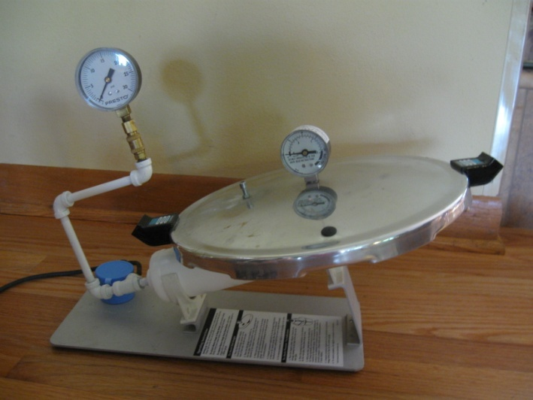
Testing Canners
Master Gauge
Dial-gauge canners should be tested at least once each year to ensure the dial is functioning properly
  Calibrate the canner gauge against the master gauge
  Canner can be off by +2 pounds
  Even brand new dials should be tested
  Presto recommends ONLY Presto lids be tested with the unit

Slide 12
Resources for Testing Canners
Dial gauge canner inspection form
  Review the condition of the gasket, vent port and gauge
  Record the accuracy of the canner gauge versus the Master gauge
  Provide overall recommendation
Gauge testing labels
Information on purchasing a Presto® dial gauge testing unit
See www.foodsafety.wisc.edu P=Pressure Canning in the A-Z index
DATE: _________________________
Recipe says: 6 lbs 11 lbs
Your gauge should read:
_____ lbs _____ lbs

Slide 13
FAQS
How long do I process quart jars of cream-style corn?
How long do I process my soup mix that contains tomatoes, corn, black beans and onion?
Do I have to peel potatoes before canning?
Can I use jars and lids that I purchased last year? What about non-Ball jars/lids?
How long can I store my home canned items?
Do I purchase a dial or weighted gauge canner?

Slide 14
FAQ- Answers
How long do I process quart jars of cream-style corn? You don’t. There are no tested recipes!
How long do I process my soup mix that contains tomatoes, corn, black beans and onion (qt jars, hot pack)? Process mixtures based on the ingredient with the longest process time – 85 min.
Do I have to peel potatoes before canning? Yes, the skins carry a higher bot spore load; potatoes must be peeled before canning. Other crops such as carrots don’t require this step.

Slide 15
FAQ - Answers
Can I use jars and lids that I purchased last year? What about non-Ball jars/lids? You can use jars and lids from last year – just be sure to store in a cool, dry location. You can use non-Ball jars/lids but they may break, or not seal, more often.
How long can I store my home canned items? Properly canned foods are safe indefinitely, but will begin to lose quality after 3 years on the shelf (assuming a cool, dry location).
Do I purchase a dial or weighted gauge canner? It’s up to you! A dial gauge canner you can ‘read’, a weighted gauge canner you can ‘hear.’

Slide 16
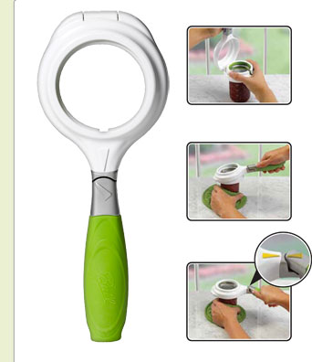
What’s new? ‘Useful’ gadgets?
Ball® SureTight Band Tool – secures jar bands with just the right amount of ‘finger-tip tightness’.
Comments on the web site indicate that it’s confusing to use.
UWEX does not, at this time, recommend the use of this tool.

Slide 17
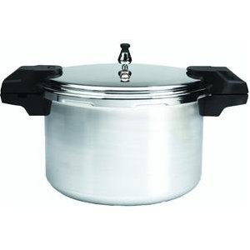
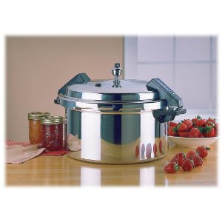
What’s new? Mirro Canners
The new Mirro 16-quart canner was recently tested by the NCHFP.
  3 separate weights (5, 10, 15 pounds)
  Heat on high until the weight jiggles, then allow to rock gently
  ➔The ‘rock’ is difficult to find. It sort of ‘explodes’ in steam release.
The Mirro 12-quart canner has shown up in MFP classes.
  3-piece ball-shaped weight.
  The weight is threaded on the vent port which can be tricky when steam is escaping (venting).
  Getting the weight to rock is difficult.

Slide 18
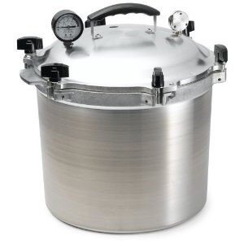
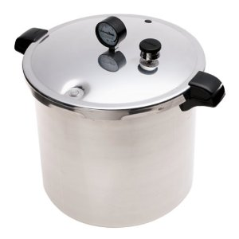
What’s new? Canners
The All-American Canner.
  Metal-to-metal seal (tightened with wing-nuts)
  A weighted gauge canner with a reference dial gauge.
  ➔These should not be/do not need to be tested with our dial testers.
Larger capacity tall canners allow for double-stacking.
  Canners such as the Presto 23-qt. model can hold 2 layers of pint jars.
  Be sure to place a rack on the bottom of the canner and between layers.

Slide 19
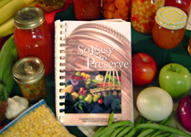
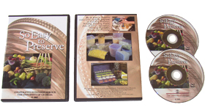
Resources
Canning Vegetables Safely www.foodsafety.wisc.edu
National Center for Home Food Preservation www.uga.edu/nchfp
Ball Complete Book of Home Preserving or Ball Blue Book online www.freshpreserving.com
So Easy to Preserve book & video series

Slide 20
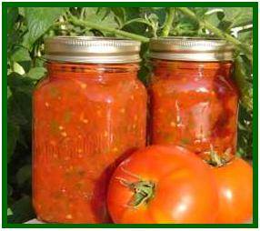
Questions?
Thank you!
Next Lunch & Learn
July 23, 2012
12 noon to 1 pm
Canning Tomatoes & Tomato Products

